Slide 1
20 Awesome Chrome
Apps & Extensions
Original ideas by Stacy Behmer,
With additions by Diane Royer
Stacy Behmer
Google Apps Certified Trainer,
Google Apps Certified Teacher
Coordinator of Digital Learning, Grant Wood AEA
sbehmer@gwaea.org, sbehmer@gmail.com
Google+
Google Voice: 319.438.2317
Twitter: sbehmer

Slide 2
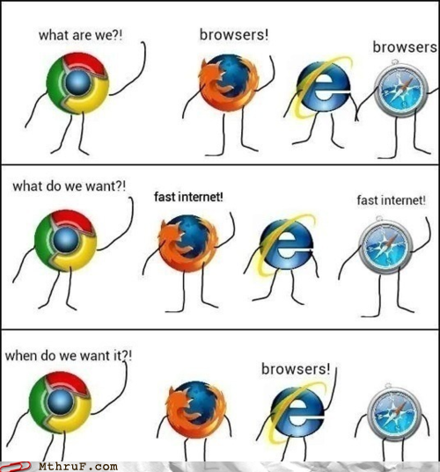
Chrome – it’s the way to go

Slide 3
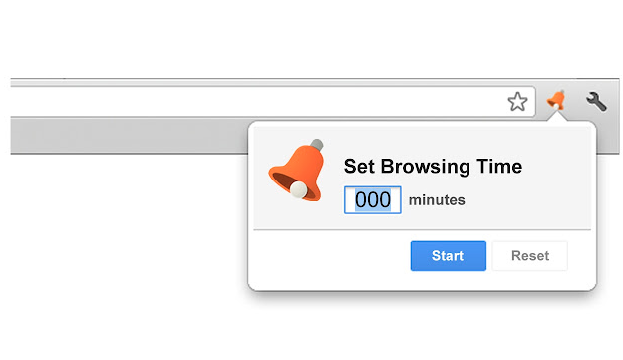
Timer
Set a countdown for students or yourself
1

Slide 4
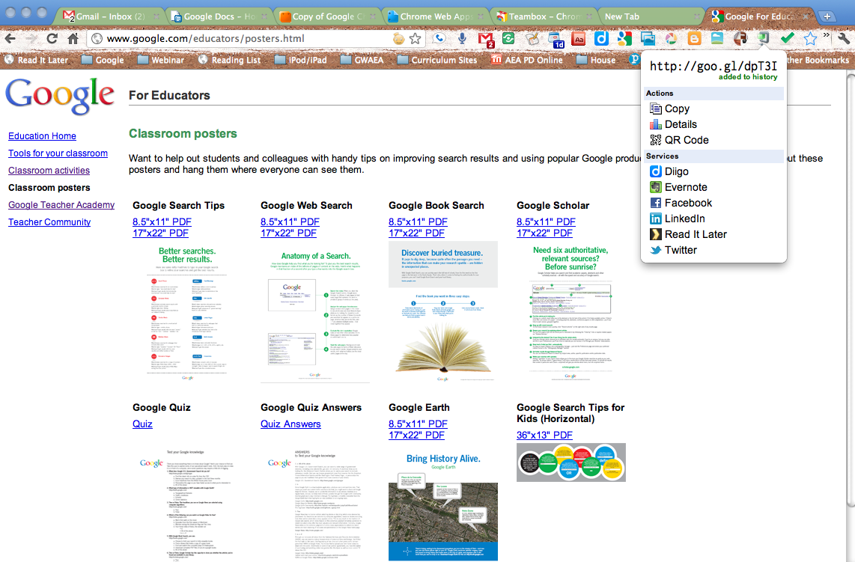
Goo.gl URL Shortner
Link to networking services
Create QR codes
2

Slide 5
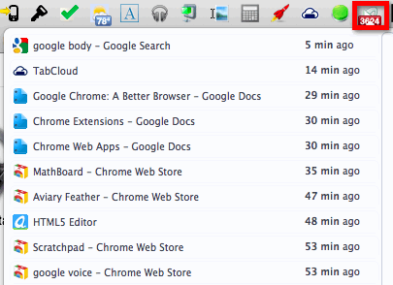
Sexy Undo Close Tab
Keeps track of all the tabs you close and you can search.
3

Slide 6
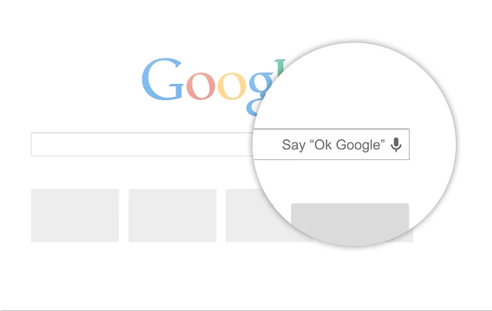
Google Voice Search By Hotword
This extension allows you to say “OK Google” and start speaking your search.
4

Slide 7
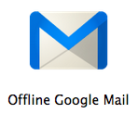
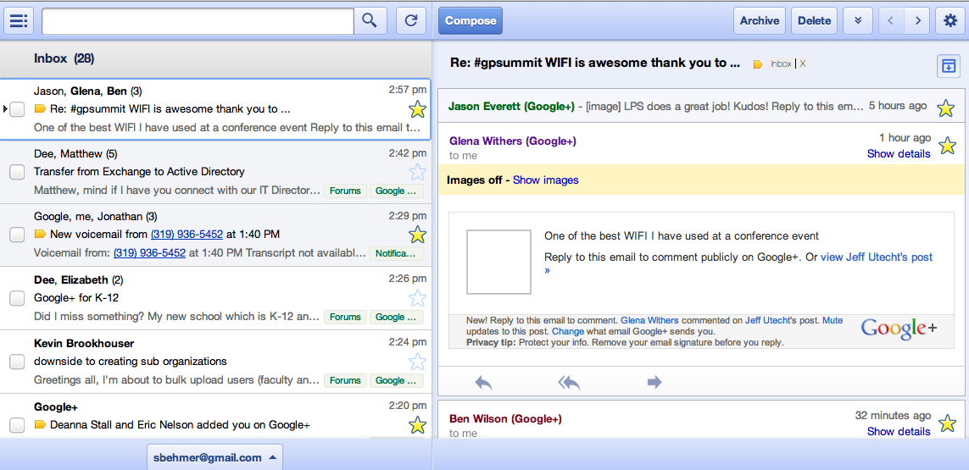
Offline Gmail
Access your email while you don't have internet
5

Slide 8
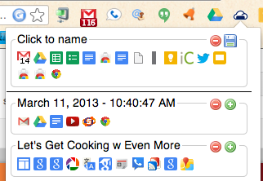
Tab Cloud
Save your tabs for future use
6

Slide 9
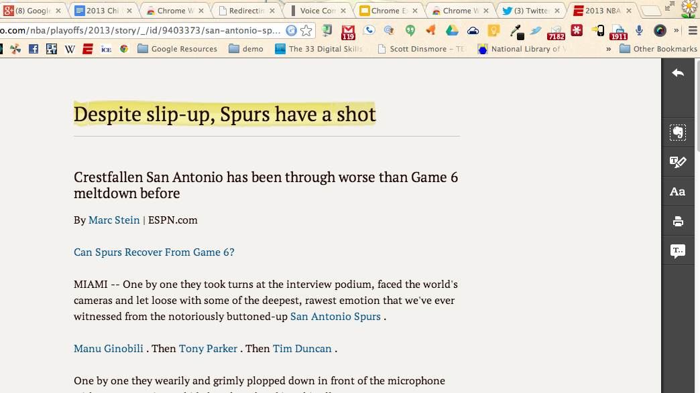
Clearly
Links with Evernote to strip down text, mark-up and text to speech.
7

Slide 10
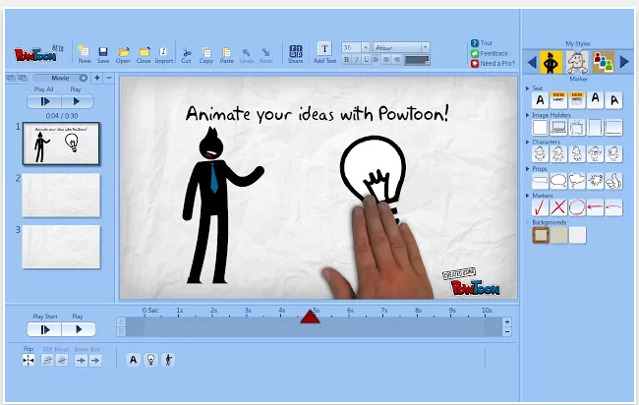
PowToon Edu
Create presentations and animated videos (saves in Google Drive)
8

Slide 11
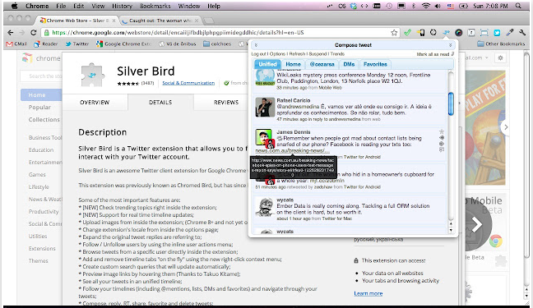
Silver Bird
Tweet and check Twitter from your browser
9

Slide 12
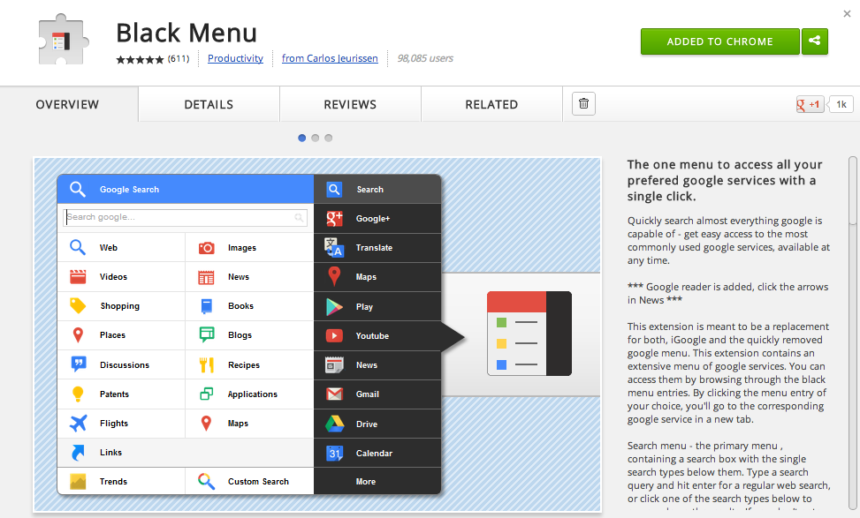
Black Menu
Get quick access to your Google Apps at one time
10

Slide 13
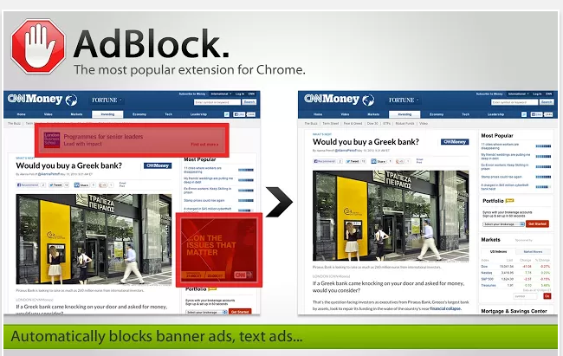
AdBlock
AdBlock for Chrome! Block all advertisements on all web pages, even Facebook, Youtube
39
11

Slide 14
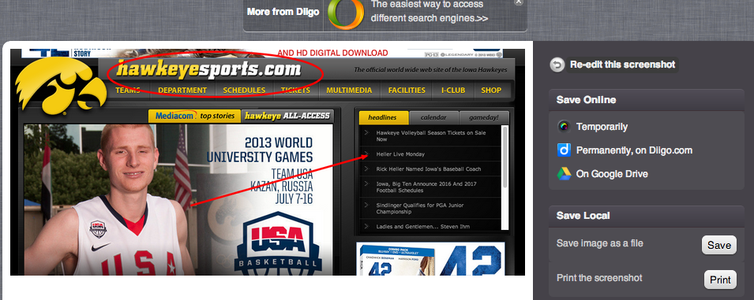
Awesome Screenshot
Take a quick screenshot and mark it up (saves to Google Drive)
12

Slide 15
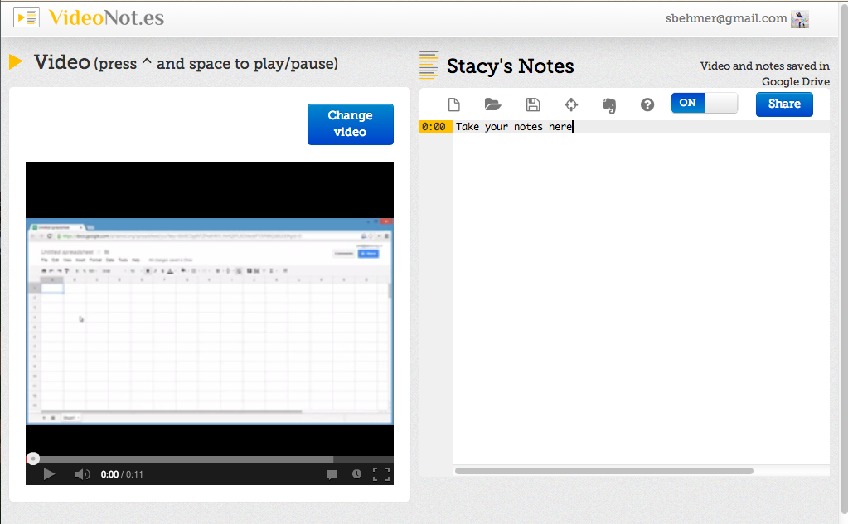
VideoNot.es
Take notes right next to a YouTube video (saves to Google Drive)
13

Slide 16
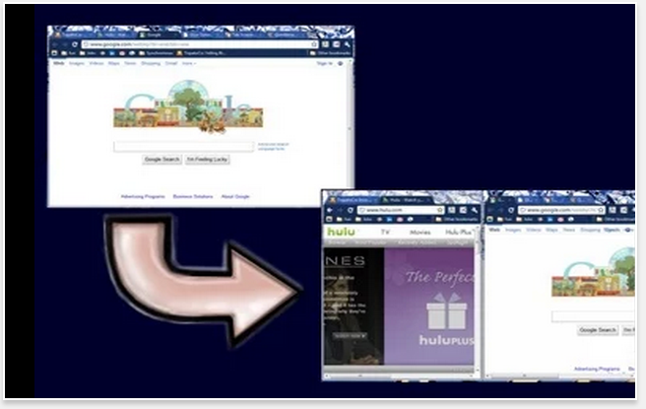
Tab Scissors and also Tab Glue
Tab scissors splits the tab into 2 window at the selection point. Tab Glue returns the windows into one screen
14 &15

Slide 17
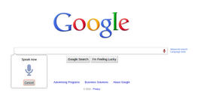
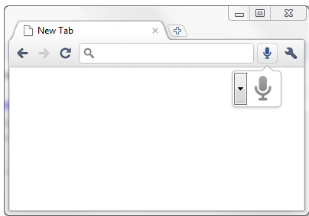
Voice Search
Fill in fields with speech by using the microphone.
16

Slide 18
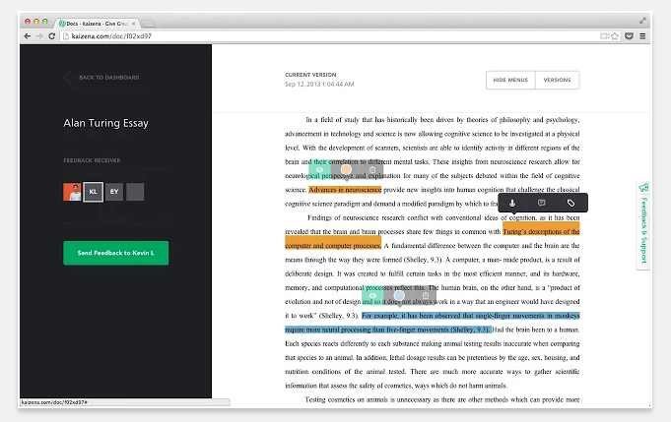
Kaizena
Highlight text and give feedback orally to students.
17

Slide 19
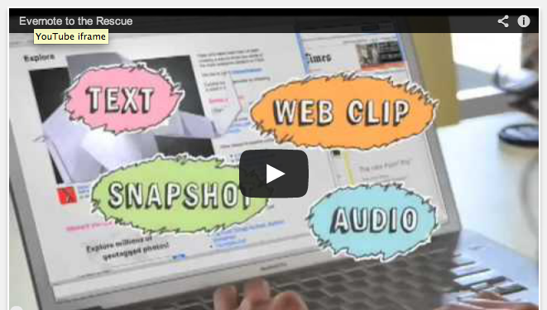
Evernote Web
Save all of your ideas and experiences in Evernote, then access the, on every computer and smart phone you use.
18

Slide 20
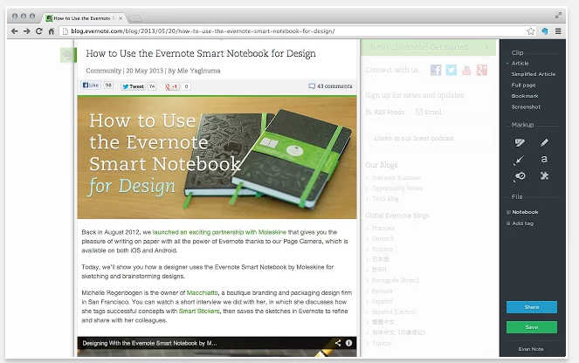
Evernote Web Clipper (an Extension)
Use the Evernote extension to save things you see on the web to your Evernote account.
19

Slide 21
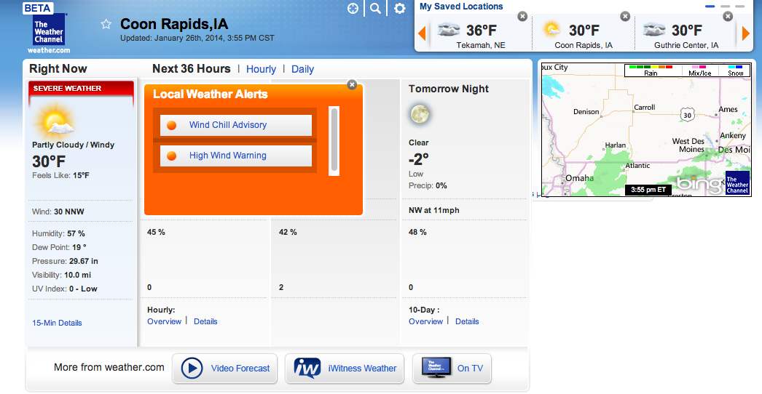
The Weather Channel
Get forecasts and current conditions for up to 9 saved locations, including radar map, hourly, daily and 36 hour forecasts.
20

