Slide 1
Intelligent Play
Diane Royer
sdroyer@gmail.com

Slide 2
The Plan
1. Gaming in the classing – a quick show and tell of some of my favorite sites, with 5-10 minutes for you to explore. (15-20 minutes)
2. Coding/programming with Scratch – an overview of why coding, then we will begin coding with an xy coordinate plane introductory activity, followed by a transformational geometry activity. (30-35 minutes)
3. Wrap up – resources, questions, comments

Slide 3
Manga High www.mangahigh.com
Not only a gaming site, but also includes practice problems matched to the common core. These practice sets are called “prodigies” and are ten questions ranging from easy to “on fire”. Students earn points for solving problems. Points are turned into digital medals.
Has global competitions. Just this year, my students have played other students in the USA, Canada, United Kingdom, Ireland, and Hong Kong.

Slide 4
Manga High Pinata Fever
Adding and subtracting integers; uses numberline, begins easy & progresses

Slide 5
Manga High Flower Power
Ordering decimals, fractions, and percents, in various combinations with problem solving as you try and turn a profit.

Slide 6
Manga High Tangled Web
Find missing angle measures, work with parallel lines and transversals, polygons, and circles

Slide 7
Manga High Pyramid Panic
Perimeter, Area
Circumference, Pythagorean Theorem, and trigonometry

Slide 8
Manga High Algebra Meltdown
One step equations, function machine, multi-step equations, and linear equations

Slide 9
Manga High Transtar
Reflections, rotations, dilations, translations, and all combinations

Slide 10
Calculation Nation http://calculationnation.nctm.org
*All of the games in Calculation Nation are organized around content from upper elementary through middle grade curriculum. These are strategy games focusing on fractions, factors, multiples, symmetry, area, and more.
*You can play against the computer, or challenge someone located anywhere in the USA
*You can “level up” as you win more games.
*Registration is free but it requires an email address, but it can be a fake one like mathgeek@none.com

Slide 12
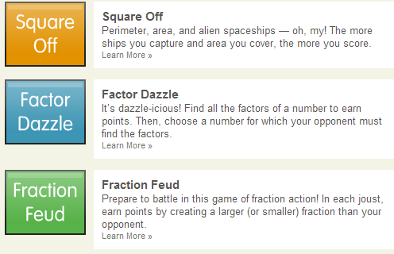

Slide 13
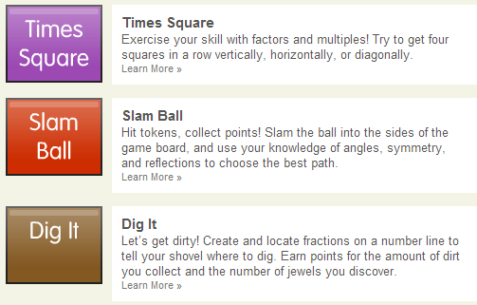

Slide 14
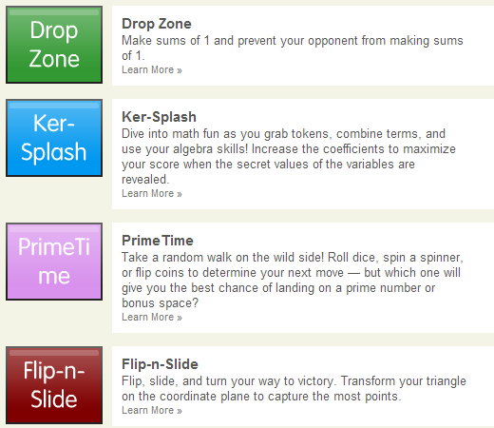

Slide 15
TenMarks www.tenmarks.com
Not a gaming site, but a good resource matched to Common Core, with ability to differentiate and enrich from first grade through Algebra 2 and Geometry.
Amazon purchased TenMarks and has just released free App for Kindle Fire.
Includes video lessons, math practice and real-time tutoring.
I use the basic, free version; paid subscription offers more features.

Slide 16
Okay – Your time to play
I would like you to choose one (or more) of the sites just mentioned, and if you do not have an account, make one, then play a game, try a prodigy, or just explore.
You’ve got 5-10 minutes, then it is on to Scratch.

Slide 17
Scratch http://scratch.mit.edu
Scratch is a programming language that makes it easy to create interactive art, stories, simulations, games and of course, math, plus you have ability to share those creations online.
Scratch is a building block program and is a great tool for STEM/STEAM programs.

Slide 18
A brief intro to Scratch

Slide 19
Available in two ways
Scratch 2.0 is the newest, web version (requires flash)
Can also download a stand alone version
*I chose to have the stand alone version available for download to my students’ computers. This eliminated the “no internet available at home” issues, and eliminated COPPA compliance issues.

Slide 21
Time to code!
Launch Scratch – either from your stand alone program or from the web
The first project we will do is an xy coordinate activity
The second project is a polygon-angle activity – like a spirograph

Slide 22
Resources
scratch.mit.edu/ (the obvious first choice)
http://www.scratch.ie/resources (Resources from University of Limerick, Ireland)
http://www.smsn.vic.edu.au/ictguy/index.php/scratch-resources/ (nice compliation from variety of sources)
http://learnscratch.org/ (has video lessons)

Slide 23
Interesting reads on coding
New York Times
theedublogger: change how you teach math
Close the gap; 20 resources to learn to code
Benefits of teaching kids to code (with embedded video to a TED talk)

